Slide 1
Analizing food business penetration in Toronto

Slide 2

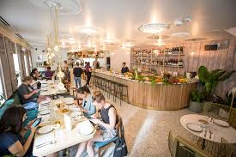

Introduction
Nowadays there is a fast increase of number of restaurants or bars on Toronto.
Many people enjoy tasting different kind of food not only on weekends but also everyday. In
There are some aspects to study such as location, kind of food, number of restaurants and population.

Slide 3

Data acquisition and cleaning
Data sources
Datasets obtained of Internet are used to solve the problem describe above. Wikipedia provides valuable information to explore and cluster the neighborhoods in Toronto.
Wikipedia page Here was scrape in order to filter the data.
Also Foursquare API allows to extract the important information such as top N sites or venues in a neighborhood

Slide 4
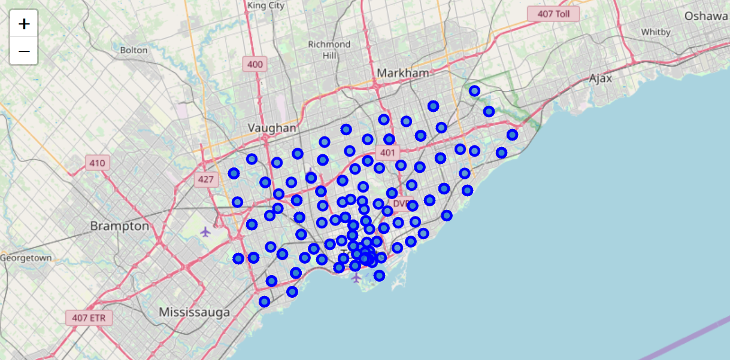
Data acquisition and cleaning
Data cleaning
Data downloaded or scraped from sources were filter into one table. Then read it into a pandas data frame to get a structured format.
Use data from 2017 year and after, because this period shows the last tends.
BeautifulSoup was used for pulling data out of HTML and XML files
Folium to visualize data that’s been processing by Python on an interactive map.

Slide 5
Data acquisition and cleaning
Feature selection
Features were selected taking into account the objective of this project. In the first Toronto post code dataset were selected the following features:
PostalCode | Borough | Neighborhood | Latitude | Longitude
M3A | North York | Parkwoods | 43.752420 | -79.329242
M4A | North York | Victoria Village | 43.730600 | -79.313265
M5A | Downtown Toronto | Harbourfront | 43.650295 | -79.359166
M6A | North York | Lawrence Heights | 43.723270 | -79.451286
M6A | North York | Lawrence Manor | 43.723270 | -79.451286

Slide 6
Data acquisition and cleaning
Feature selection
After use Foursquare the features that were selected are:
Postal Code | Neighborhood | Neighborhood Latitude | Neighborhood Longitude | Venue | Venue Summary | Venue Category | Distance
M5A | Harbourfront | 43.650295 | -79.359166 | The Distillery Historic District | This spot is popular | Historic Site | 13
M5A | Harbourfront | 43.650295 | -79.359166 | Distillery Sunday Market | This spot is popular | Farmers Market | 216
M5A | Harbourfront | 43.650295 | -79.359166 | Arvo | This spot is popular | Coffee Shop | 187
M5A | Harbourfront | 43.650295 | -79.359166 | Cacao 70 | This spot is popular | Dessert Shop | 127
M5A | Harbourfront | 43.650295 | -79.359166 | SOMA chocolatemaker | This spot is popular | Chocolate Shop | 91

Slide 7
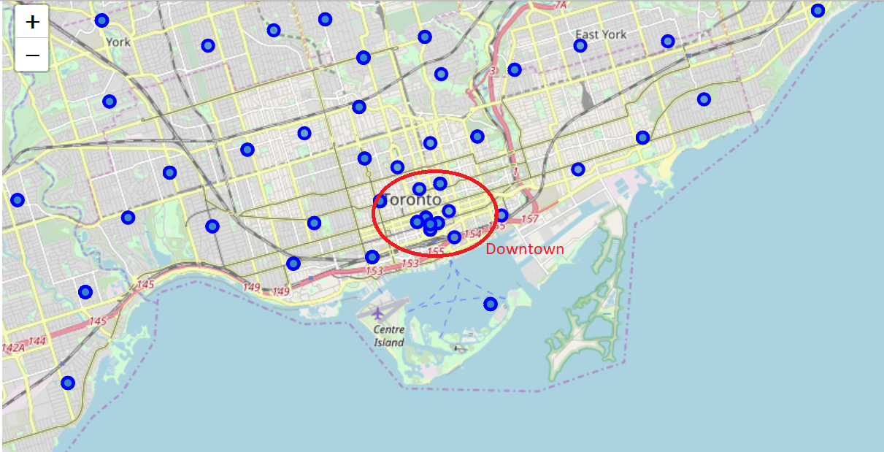
Methodology
Exploratory Data Analysis
  The first task of analysis of data was to examine population density on Toronto by create a map

Slide 8
Methodology
Exploratory Data Analysis
  The study focused in Downtown Toronto based population density.
 | PostalCode | Borough | Neighborhood | Latitude | Longitude
2 | M5A | Downtown Toronto | Harbourfront | 43.650295 | -79.359166
5 | M7A | Downtown Toronto | Queen's Park | 43.661150 | -79.391715
12 | M5B | Downtown Toronto | Ryerson\n | 43.657363 | -79.378180
13 | M5B | Downtown Toronto | Garden District\n | 43.657363 | -79.378180
26 | M5C | Downtown Toronto | St. James Town | 43.651210 | -79.375481

Slide 9
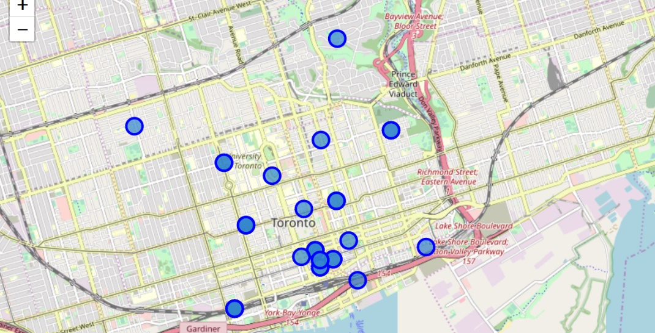
Methodology
Exploratory Data Analysis
  Showing Downtown Toronto and its neighborhoods

Slide 10
Methodology
Exploratory Data Analysis
  Using foursquare to locate venues in the neighborhoods inside "Downtown". In this process 3217 registers were analyzed
Postal Code | Neighborhood | Neighborhood Latitude | Neighborhood Longitude | Venue | Venue Summary | Venue Category | Distance
M5A | Harbourfront | 43.650295 | -79.359166 | The Distillery Historic District | This spot is popular | Historic Site | 13
M5A | Harbourfront | 43.650295 | -79.359166 | Distillery Sunday Market | This spot is popular | Farmers Market | 216
M5A | Harbourfront | 43.650295 | -79.359166 | Arvo | This spot is popular | Coffee Shop | 187
M5A | Harbourfront | 43.650295 | -79.359166 | Cacao 70 | This spot is popular | Dessert Shop | 127
M5A | Harbourfront | 43.650295 | -79.359166 | SOMA chocolatemaker | This spot is popular | Chocolate Shop | 91

Slide 11
Methodology
Exploratory Data Analysis
Postal Code | Neighborhood | Neighborhood Latitude | Neighborhood Longitude | Venue | Venue Summary | Venue Category | Distance
M4Y | Church and Wellesley | 43.666585 | -79.381302 | Starbucks | This spot is popular | Coffee Shop | 699
M4Y | Church and Wellesley | 43.666585 | -79.381302 | Okonomi House お好みハウス | This spot is popular | Japanese Restaurant | 495
M4Y | Church and Wellesley | 43.666585 | -79.381302 | GoodLife Fitness | This spot is popular | Gym | 591
M4Y | Church and Wellesley | 43.666585 | -79.381302 | The Captain's Boil | This spot is popular | Seafood Restaurant | 501
M4Y | Church and Wellesley | 43.666585 | -79.381302 | Bulk Barn | This spot is popular | Grocery Store | 594

Slide 12
Methodology
Exploratory Data Analysis
  Filtering restaurant feature
['Neighborhood',
'Neighborhood Latitude',
'Neighborhood Longitude',
'American Restaurant',
'Asian Restaurant',
'Caribbean Restaurant',
'Chinese Restaurant',
'Fast Food Restaurant',
'Filipino Restaurant',
'Greek Restaurant’,
……………………………..']

Slide 13
Methodology
Exploratory Data Analysis
  K-means was used to group restaurants and evaluate the best place to open a new restaurant. I decide to create 4 clusters considering the distances obtained in the previous results.
Neighborhood Latitude | Group
43.630210 | 1.0
43.640815 | 2.0
43.645160 | 1.0
43.647100 | 4.0
43.648280 | 4.0
43.648395 | 4.0
43.648690 | 1.0
43.649700 | 4.0
43.650295 | 1.0
43.651210 | 1.0
43.653530 | 3.0
43.656091 | 1.0
43.657363 | 1.0
43.661150 | 1.0
43.663110 | 1.0
43.666585 | 1.0
43.668160 | 1.0
43.668781 | 1.0
43.682205 | 1.0

Slide 14
Results
The purpose of this project was to analyze the best place to open a new restaurant in Toronto. According to the results there are two ideal neighborhoods: CN Tower and Chinatown. In these neighborhoods the restaurants offer is not saturated.
{'Postal Code': 'M5V’,
'Neighborhood': 'CN Tower’,
'Neighborhood Latitude': 43.64081500000003,
'Neighborhood Longitude': -79.39953781899999}
{'Postal Code': 'M5T’,
'Neighborhood': 'Chinatown’,
'Neighborhood Latitude': 43.653530000000046,
'Neighborhood Longitude': -79.39723268299997}

Slide 15

Discussion
Despite of the goals reached of this project, I think that there are further improvement and development that can be done. For instance, kind of food that offer each restaurants or hours with more clients. These would deep ore the study and increase the probability of success to star the business.

Slide 16


Conclusion
This study could very useful to determine the probability of success before to start a business. The initial investment to open a bar or restaurant is high, so many people need to know all information that guarantee preserve their money. The study done is good marketing tool.
Foursquare is a good API to get venues and user preferences in data analyzing.
There is a lot of information published on Internet that can be processed for many studies.
Phyton and its libraries are very useful to filter data, it is a simple language with many advantages.

